Slide 1
Setting Up Your Canvas Course
Dr. Jasmine Bryant, Director

Slide 2
Outline
Canvas syllabus
Course Home Page / selection and design
Course navigation
Select a grade posting policy
Modules
Assignments
Grades
Communicating
Student view
Publish your course

Slide 3
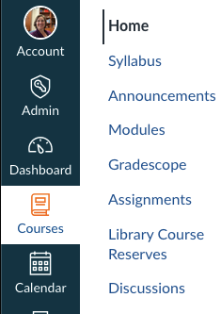
Canvas Syllabus / Canvas Course Index
The ”Syllabus” page is where students look for course policies and important due dates. It’s a special page in Canvas
This page, once published, can be viewed by anyone with a Caltech Canvas account through the Canvas Course Index – a great way to allow prospective students to view your course information.
https://caltech.instructure.com/search/all_courses/
Do not post files to this page that you do not want made available to people NOT enrolled in your course (answer keys, problems, sets, etc.)

Slide 4
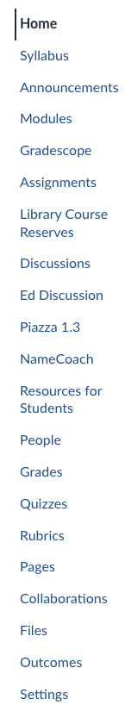

Creating Pages
In addition to the Syllabus, you can create a page to say anything you want: a Welcome message, content you want students to read through, a schedule of lecture / homework / exams, etc.
Steps:
1. Click “Pages” in the left-hand navigation. This will take you to the list of pages in the Canvas course.
2. To Create a new page, click +Page in the upper-right- hand corner.
3. Remember to “Save & Publish” when you are done editing your new page.

Slide 5
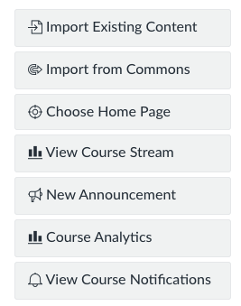
Course Home Page / Selection and Design
This is the page that students will land on when they enter your course.
At the beginning of the course, you may want this to be a Welcome message page, syllabus page, or the course modules (course modules is the default now).
After the course is under way, it is best to change the course home page to a page that students need to visit the most (likely your modules page).
To set a new Home Page, open your course and click “Choose Home Page” in the right-hand navigation.

Slide 6
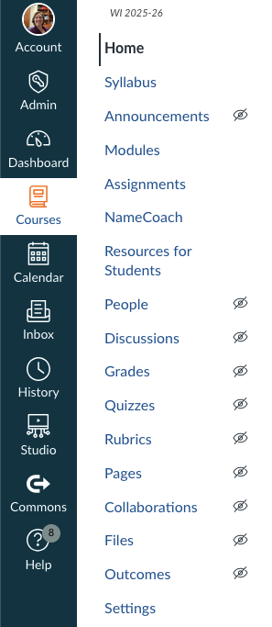
Course navigation
Each Canvas course has a left-hand navigation that you can customize.
Control which links appear in your course navigation, removing links students won't need and adding those they will. To change, choose “Settings”, then click the “Navigation” tab:
Drag and drop to edit the menu
Not visible to students

Slide 7
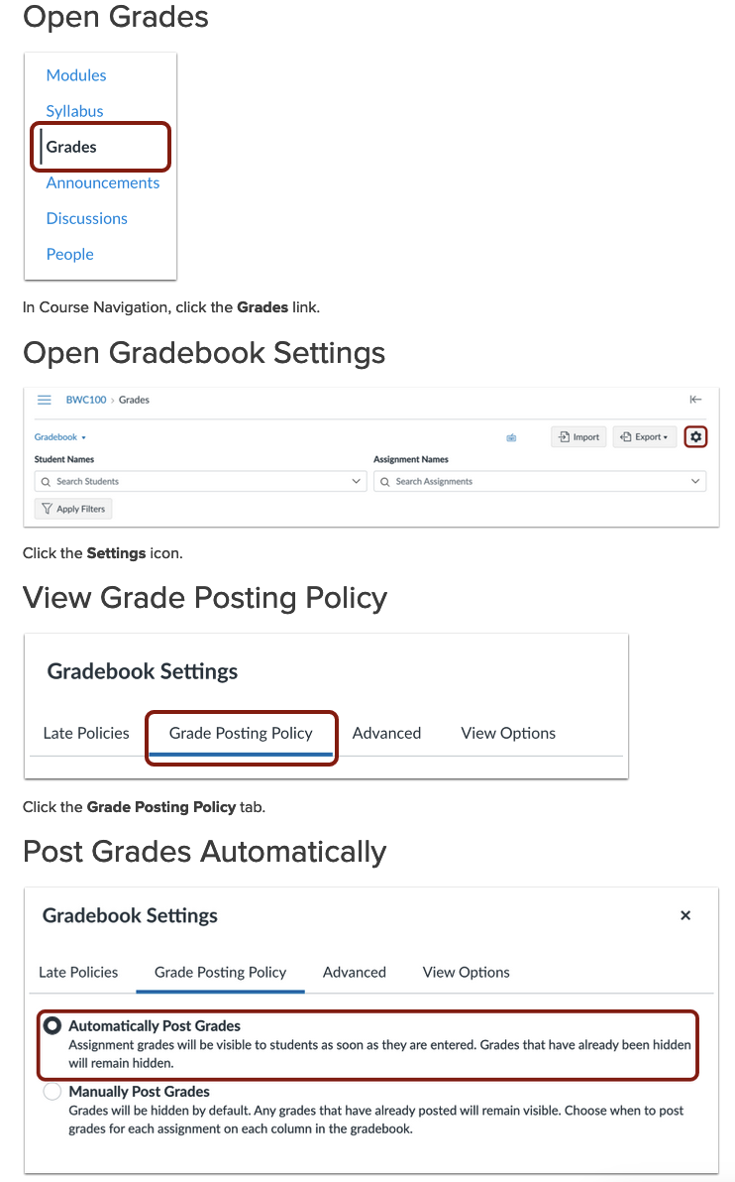
Select a Grade Posting Policy
The grade posting policy determines when students can see grades you enter in the course. You can choose a posting policy for the entire course or for individual assignments. If you select:
A manual posting policy (recommended), assignment grades remain hidden from student view by default until you post grades for the assignment.
An automatic posting policy, students can see assignment grades as soon as they are entered in the gradebook.

Slide 8
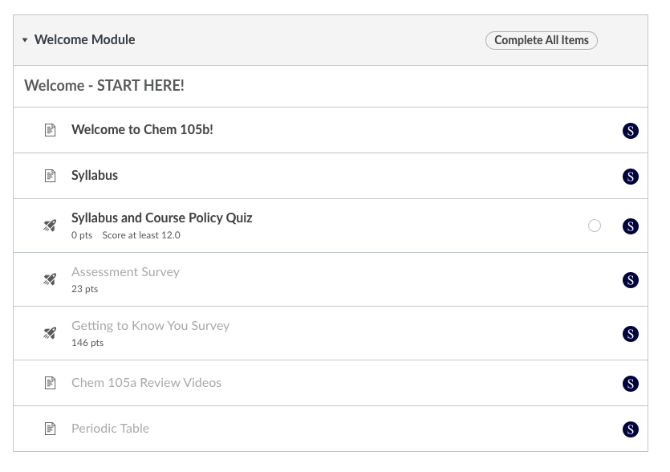
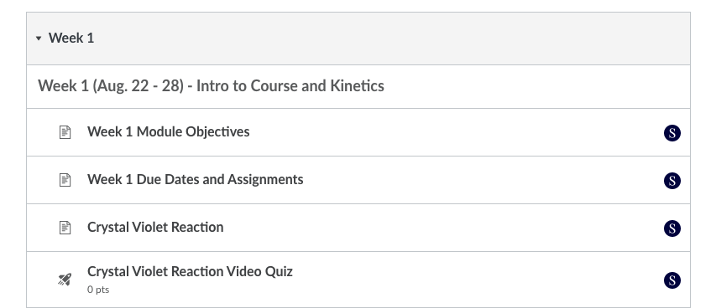
Modules and Prerequisites / Requirements
Decide how you will organize content. We recommend using clearly-titled modules, so it is clear to students where to find important information.
Start with a “Welcome – Start Here” module
Organize other content by week, unit, or type

Slide 9
Assignments
Assignments can be built and graded in Canvas or can be linked to external tools like Gradescope.
Quizzes can be created in Canvas that can be automatically graded (great for pre-class knowledge checks), manually graded (like homework assignments), or a mixture of both.
Larger projects can also be graded using complex matrix-like rubrics simply and quickly in Canvas Speedgrader.
Gradescope is an excellent tool for grading exams and problem sets.
Consider creating ”Assignment Groups” to weight scores and / or drop scores automatically.

Slide 10
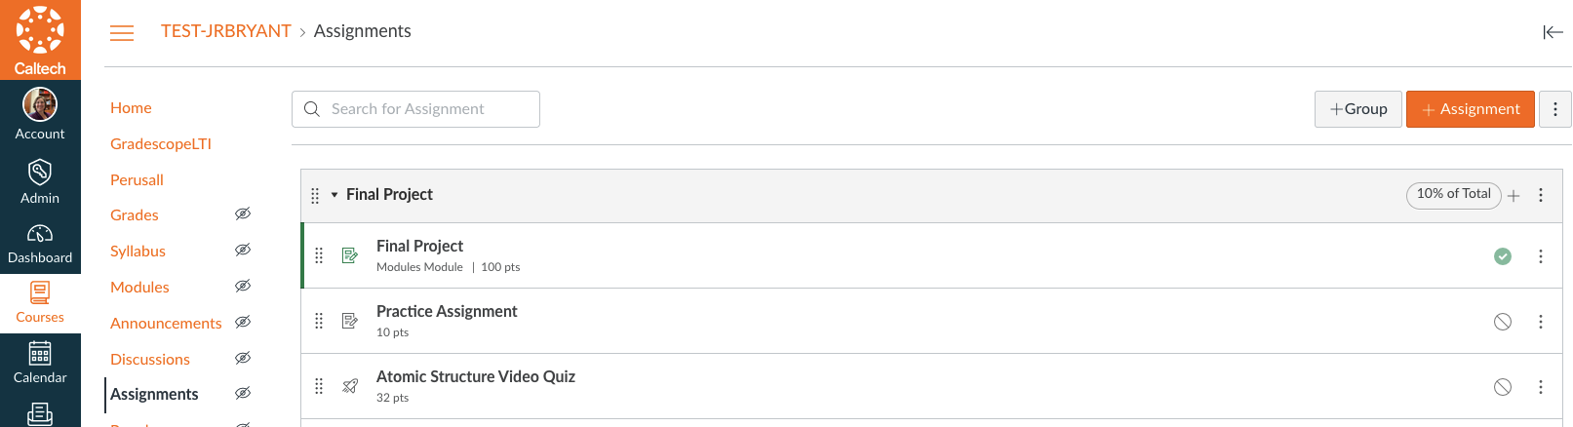
Weighting Grades
In ”Assignments”, create an “Assignment Group”.

Slide 11
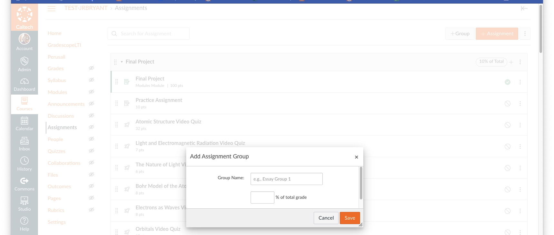
Weighting Grades
Name your group and assign the course weighting as a percentage. Already existing assignments can be dragged or moved to this new category.

Slide 12
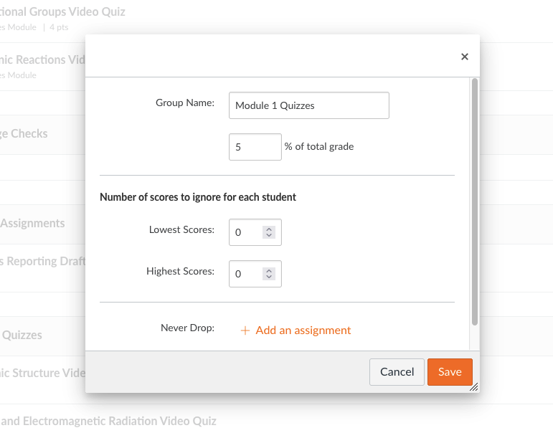
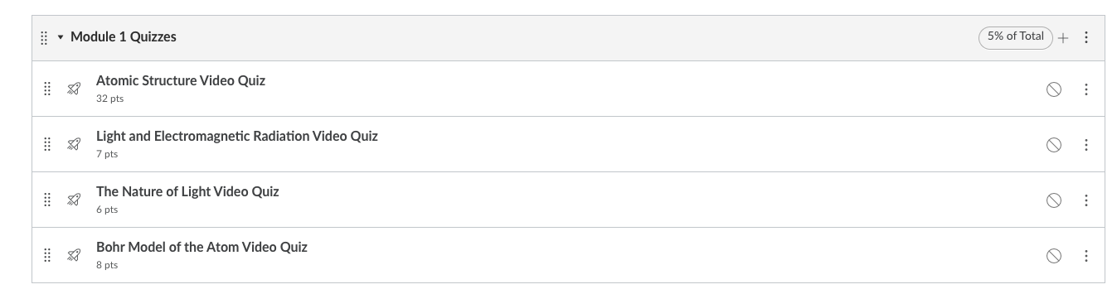
Dropping Scores
To drop scores, choose “edit” in the assignment group

Slide 13
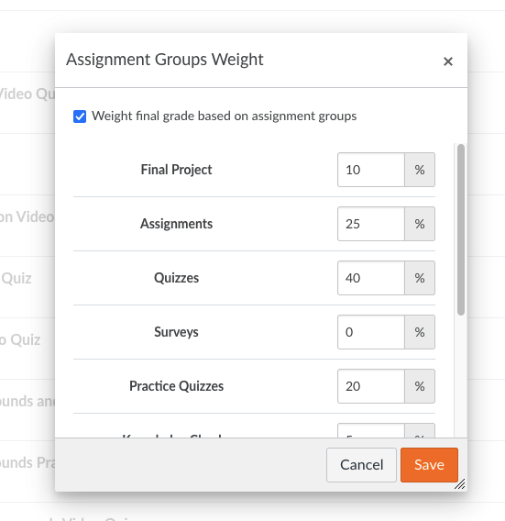
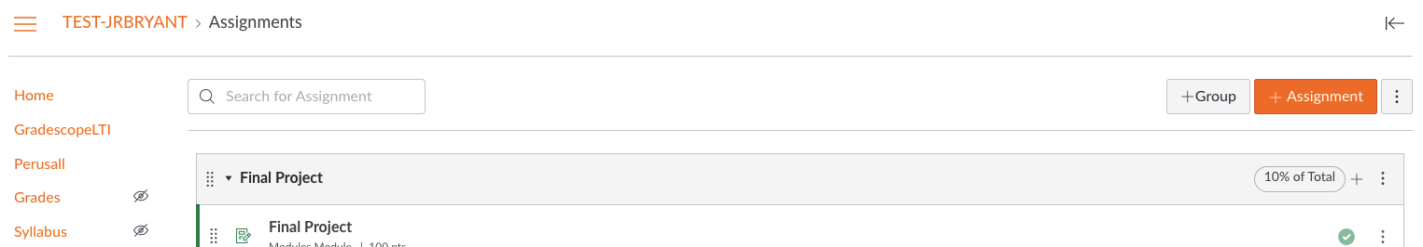
Repeat the Process
For each category of assignments in your course, create and assignment group and specific the percentage. Ungraded assignments (like surveys) can be assigned to a group with 0% weighting or simply marked as “ungraded” in the settings for the assignment.
To review your settings, click the three-dot menu on the “assignments” page and choose “Assignment Groups Weight”. Note that Canvas allows your total to exceed 100%

Slide 14
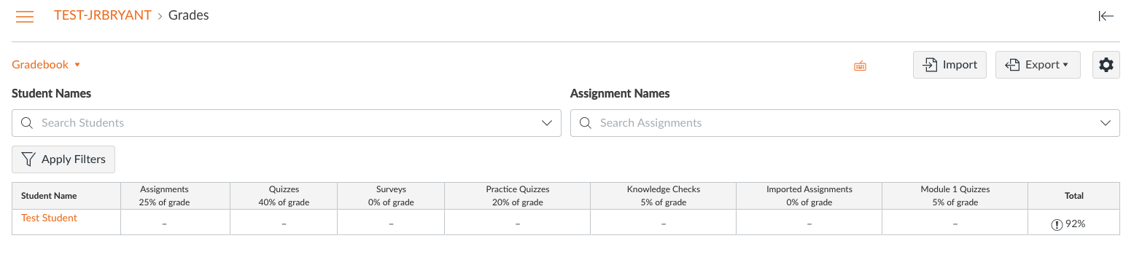
Gradebook
The Canvas Gradebook will break down overall scores by assignment group and weighted total.

Slide 15
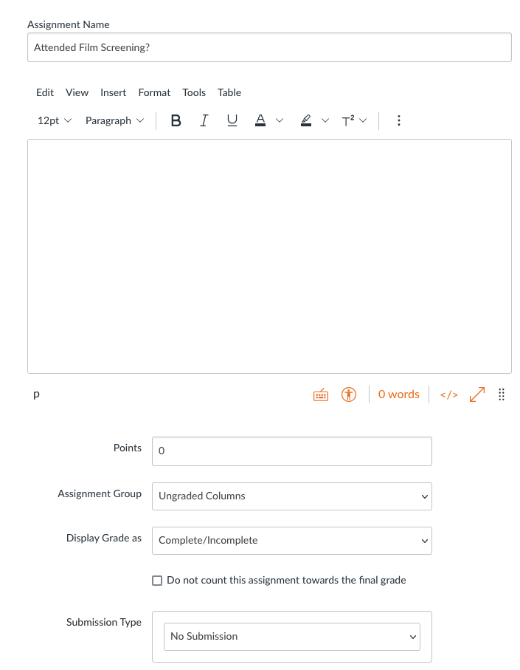
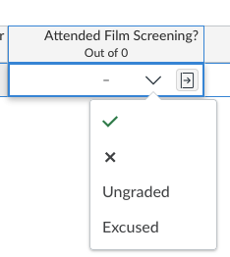
Create Tracking Columns
You can use the Canvas Gradebook to track completion (rather than just scores), even for non-assignment categories. For example, let’s say you want the gradebook to display whether or not a student attended an optional event:
1. Create a “no submission assignment” (Assignments → +Assignment).
2. Choose “Complete / Incomplete in “Display Grade as”.
3. Select “No submission” for submission type.

Slide 16
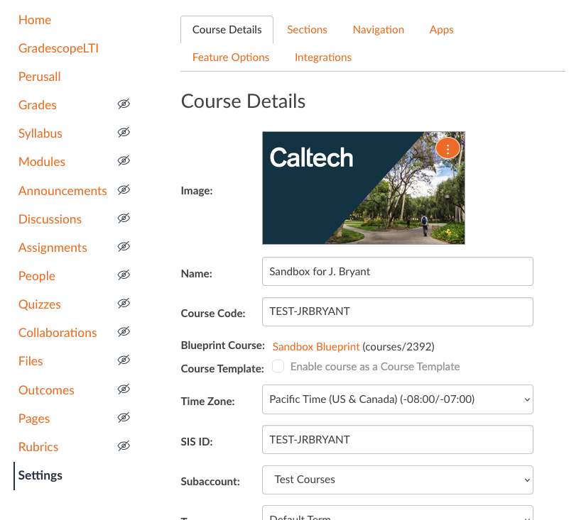
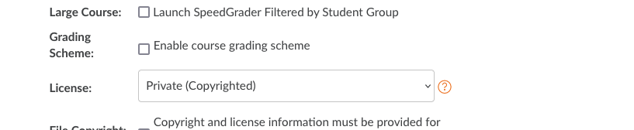
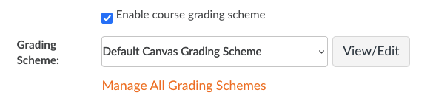
How to display course grades as letters
In “Settings” → “Course Details”
Scroll down and check the box “Enable course grading scheme”
Be sure to click “Update Course Details” when you are done.

Slide 17
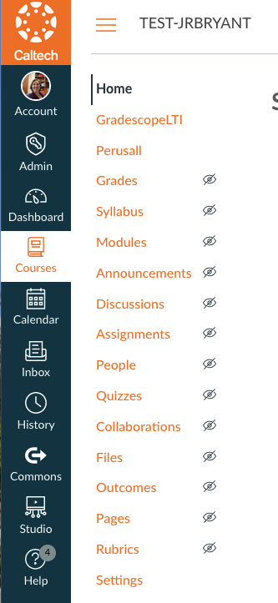
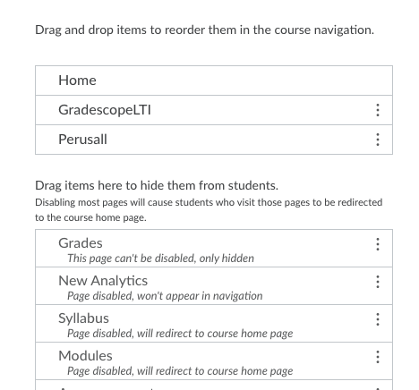
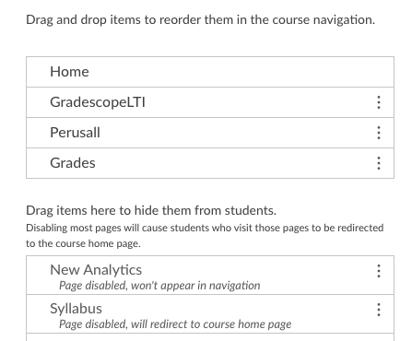
Don’t forget to make grades visible to students
Go to Settings → Navigation and drag “Grades” up to the course navigation area:
Students can’t see their grades if this symbol is shown

Slide 18
Communicating
Canvas has multiple ways to communicate with students: announcements, discussions, inbox, chat, new analytics.
Announcements help you reach a large number of students at once
Discussions within Canvas provide an integrated system for you and your students to start and contribute to discussion topics.
Canvas Conversations uses the Inbox/Messages within the Global Navigation area to deliver and send messages in multiple formats between instructors and students – send to one or all students.
New Analytics can be used to communicate to students who are missing an assignment, scored poorly (or well), etc.
Be sure to tell students how you will communicate with them and what notification settings they should use.

Slide 19
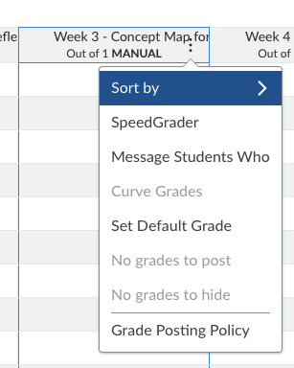
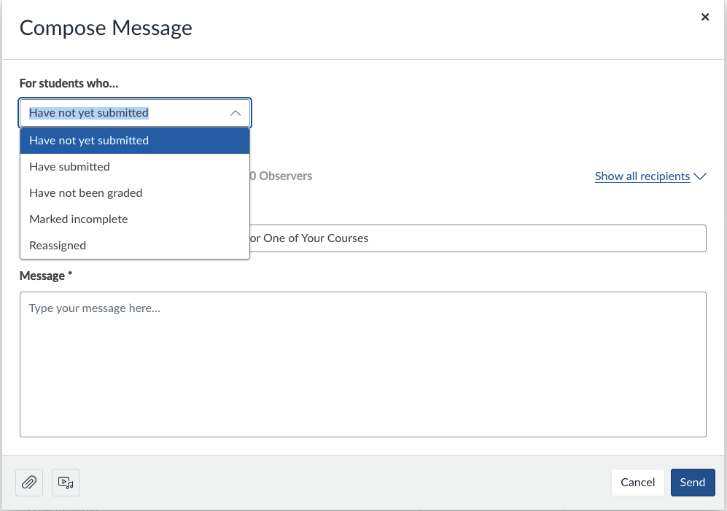

Communicating Through the Gradebook
You can message specific students via the course gradebook:
In the gradebook, hover over the right-hand corner of the assignment and click on the three dots
Select “Message Students Who”
From there, select which students to message…

Slide 20
Student View
When your course is ready to show to students, take a few extra minutes first to view it in Student View
This can help you determine if you have forgotten to publish something, if the content and order are clear, etc.
(Your “Student View” test identity shows up in your course as “Test Student”)

Slide 21
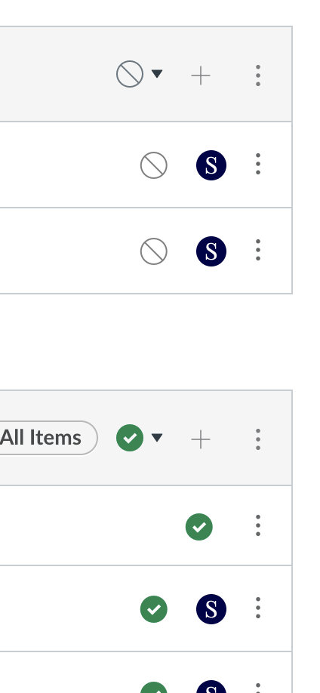
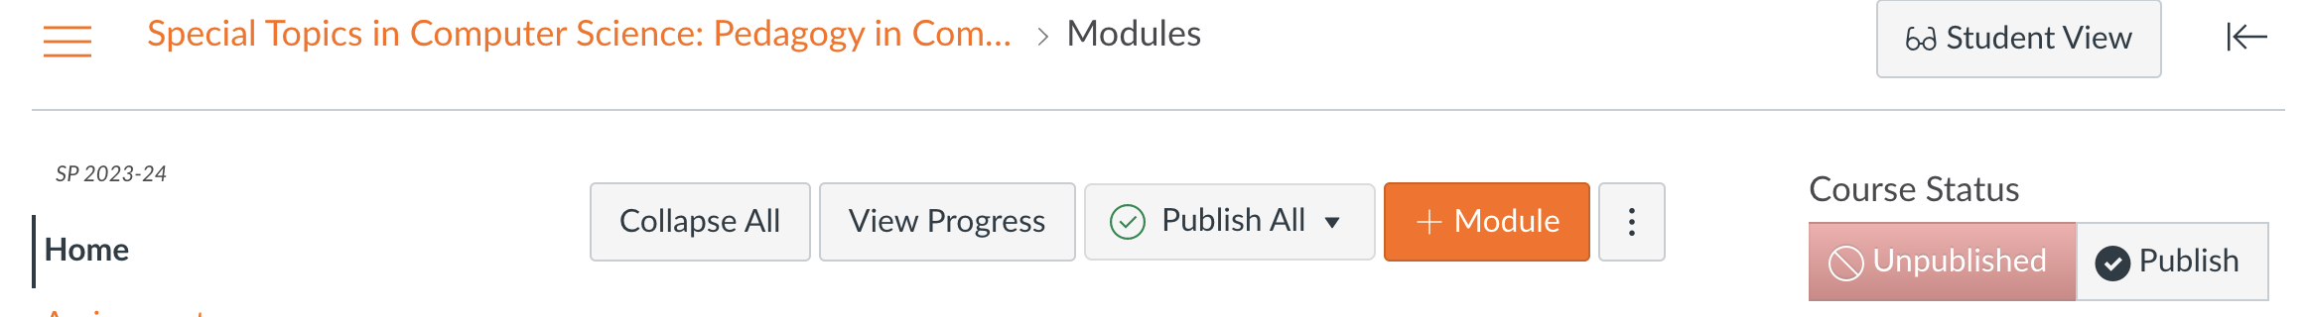
Publish Your Course
If there isn’t a green check by it, students can’t see it!
Your students won’t be able to interact with any part of your course until you publish the entire course:
Individual items in your modules AND your modules must be published, too.

Slide 22
A Note About Course Content
FERPA is a law that protects student privacy.
You are not allowed to post any material in your Canvas course that contains names and / or images of students who are not enrolled in the course (such as videos you or someone else recorded during the pandemic that students appear in).

Slide 23
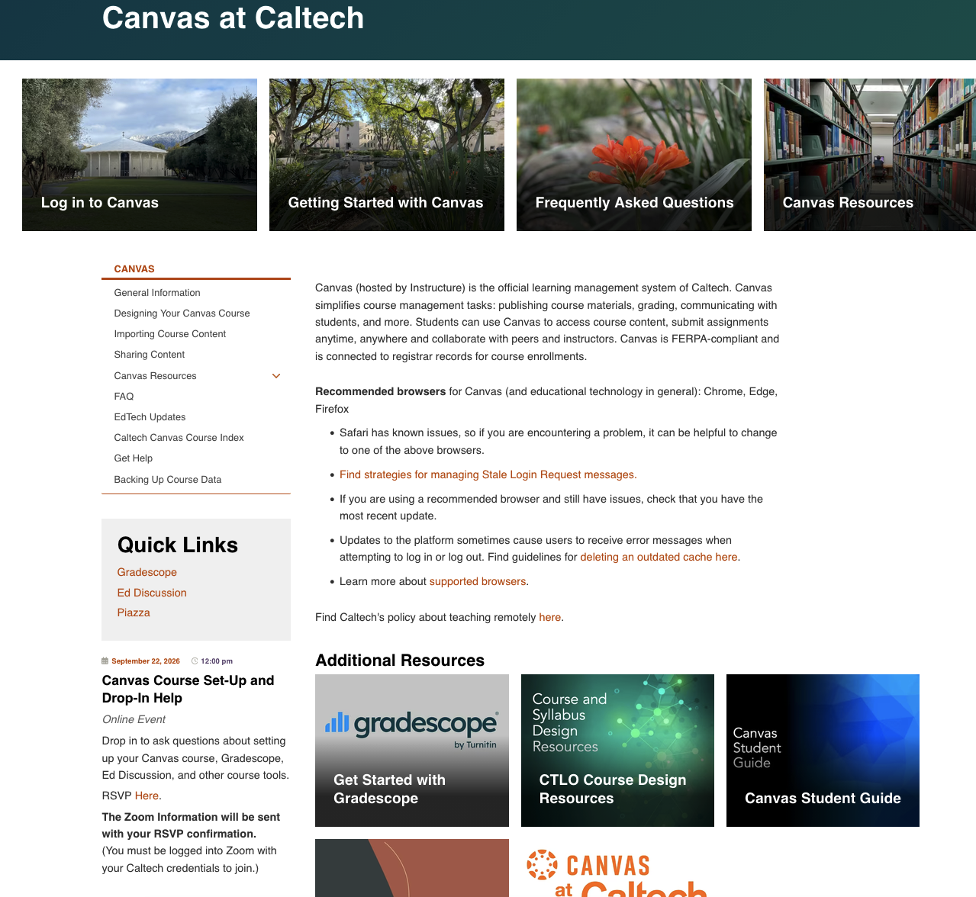
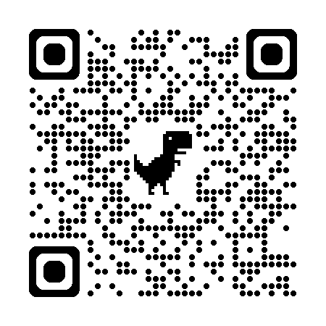
Resources
Resource page: canvas.caltech.edu
Course Design Studio:
https://caltech.instructure.com/courses/10143

Slide 24
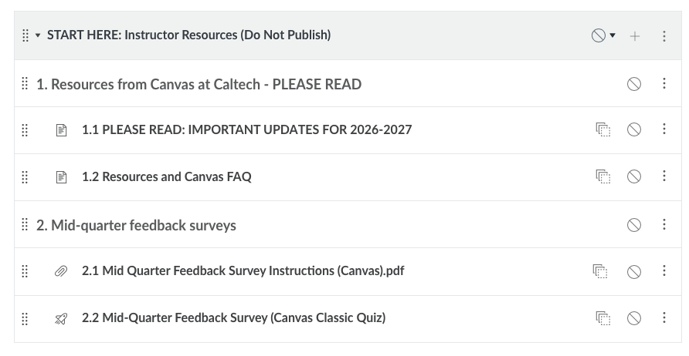
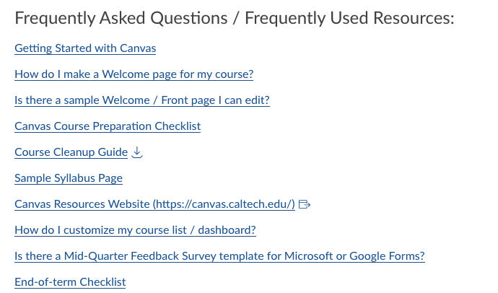
Resources
In your Canvas course modules

Slide 25
Questions?

