Slide 1
Getting Started with Gradescope
Dr. Jasmine Bryant, Director, CTLO

Slide 2
Outline
Connecting to Canvas
Creating assignments
  template
  student submission
Grading tips and tricks

Slide 3
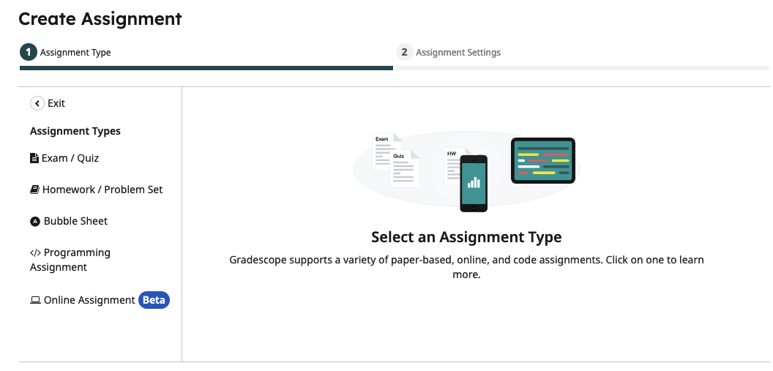
Introduction to Gradescope
Gradescope is a grading tool ideally suited for grading quizzes, exams, problems sets, and coding assignments.
Grading rubrics are easily configured, updated, and edited.
Allows simultaneous grading by multiple graders.

Slide 4
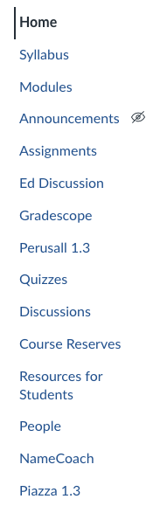
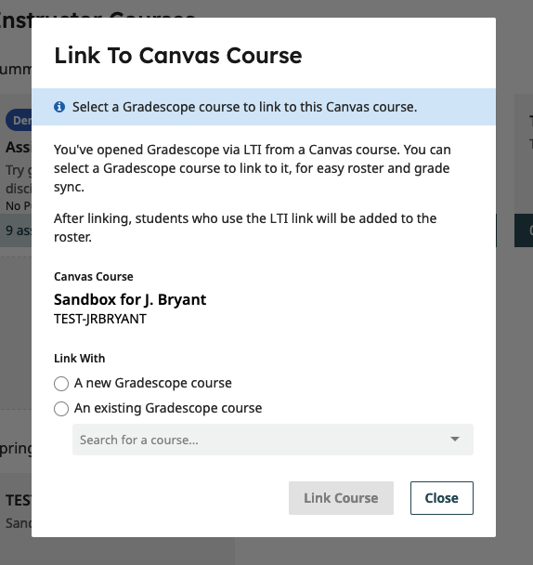
Connecting to Canvas
The best way to set up Gradescope in your course is through the Gradescope LTI in Canvas – this will allow easy syncing of scores and course enrollment (no enrollment code needed for students).
2. Link your course and choose your settings.
1. From your Canvas course, click “Gradescope”

Slide 5
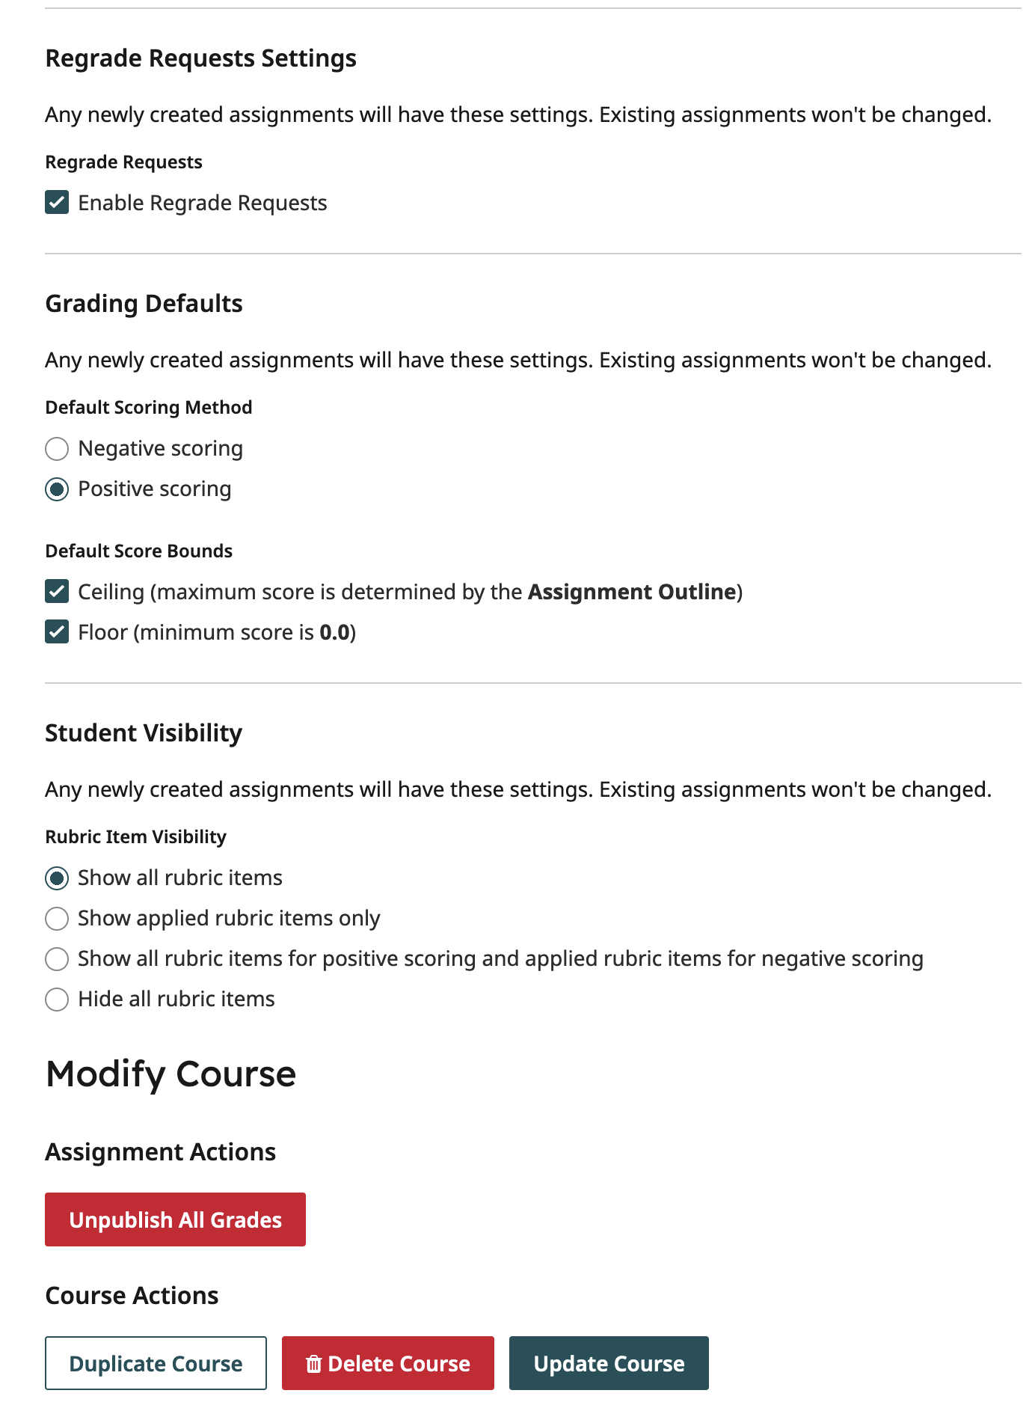
Course Settings
Course Settings to consider:
Regrade requests manage student requests to correct scoring errors - they can be opened and closed by date/time.
Positive vs. negative scoring - will your points add up to a total or be deducted from the maximum?
When students get scores back, should they see all the rubric items or just the ones applied to their score?
Be sure to “Update Course”.

Slide 6
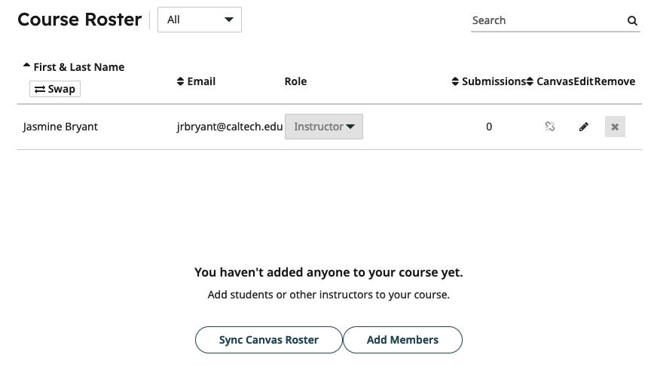
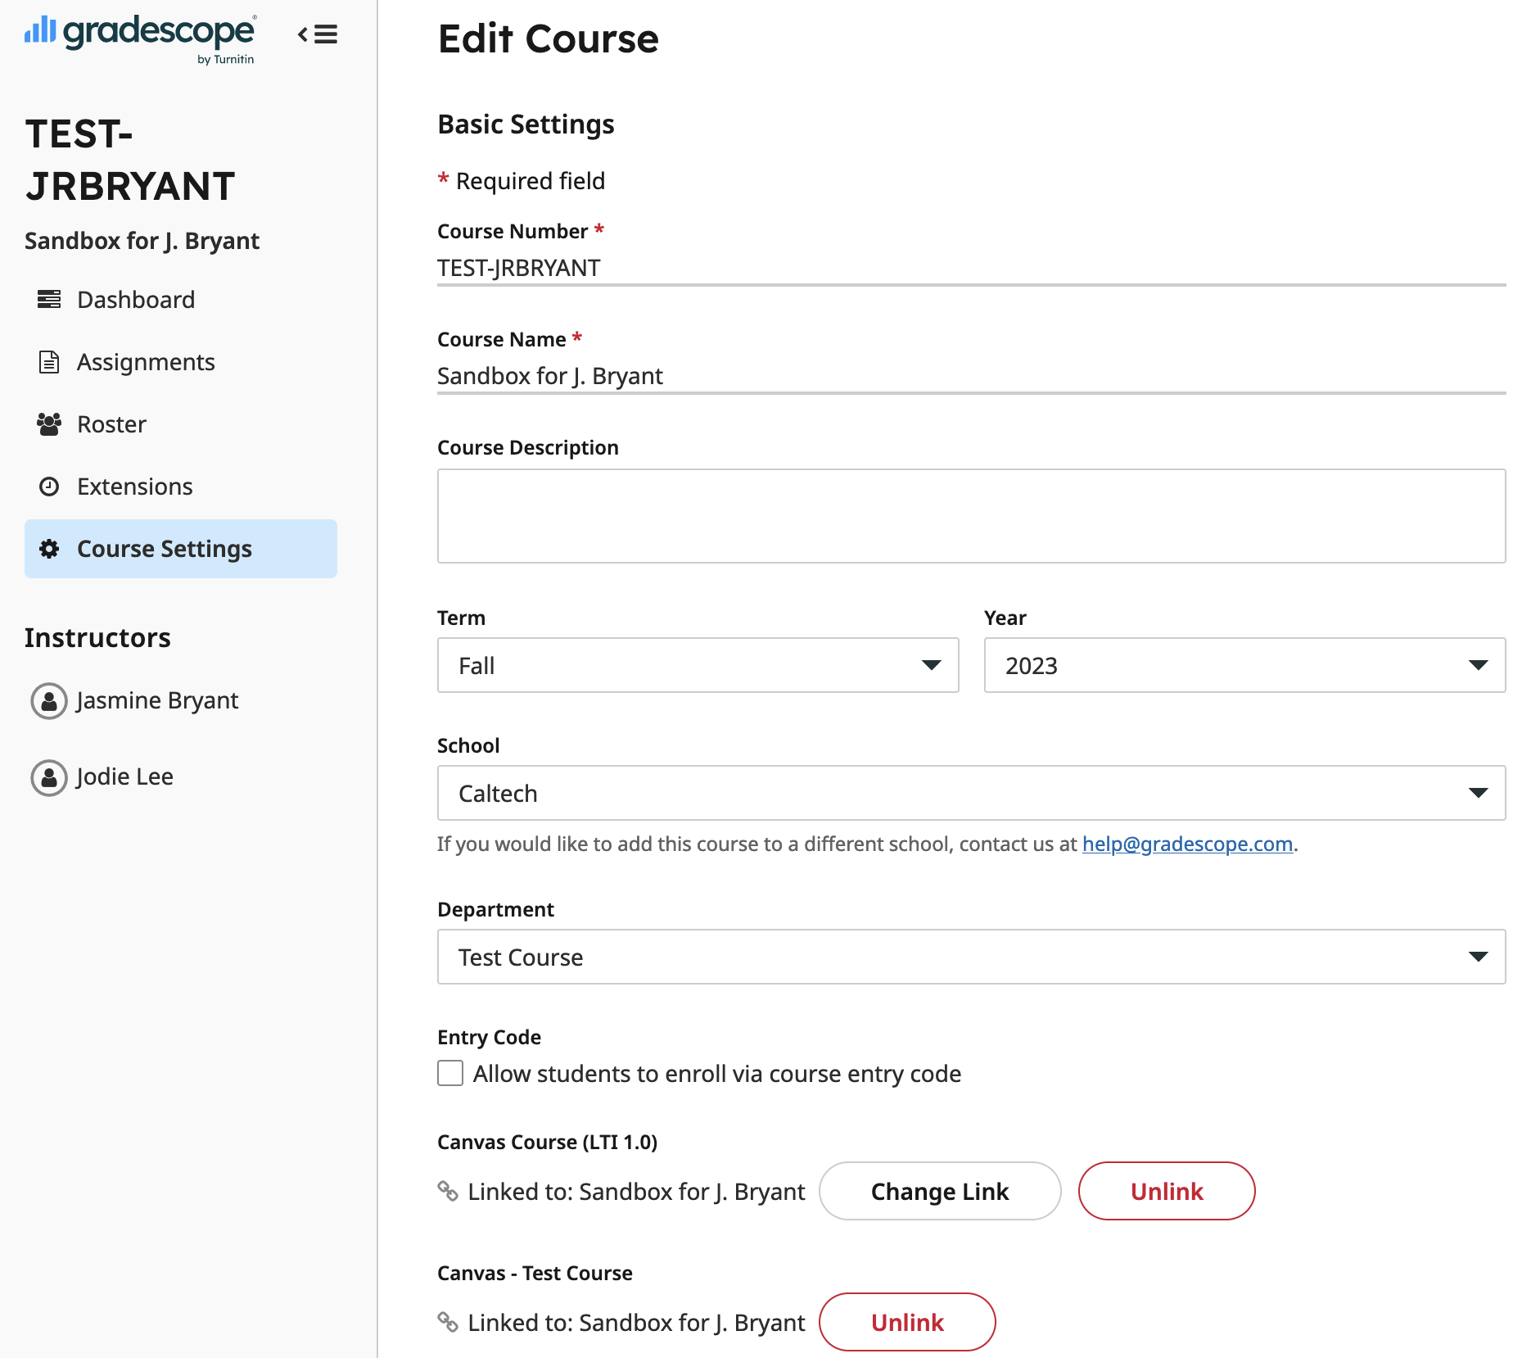
Sync your course roster
After updating your course details, it’s time to add students. (Note: This process should be repeated if course enrollments change - it is not an automatic sync.)
Sync your course roster:
Note: If you’re not using Canvas, students and TAs can be added manually using an .csv file

Slide 7
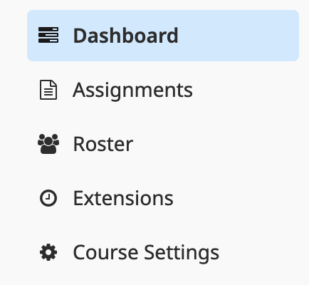
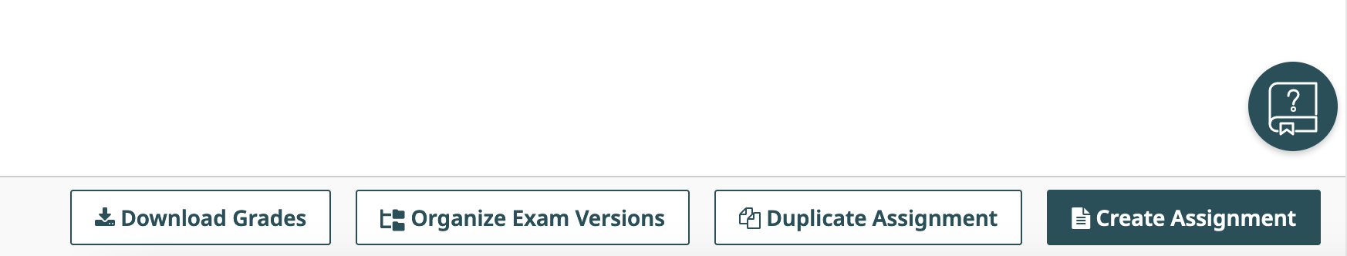
Creating Assignments – in Gradescope
To create your first assignment, click “Create Assignment” at the bottom of the assignment page. (You can also duplicate assignments from previous terms.) Select your assignment type.

Slide 8

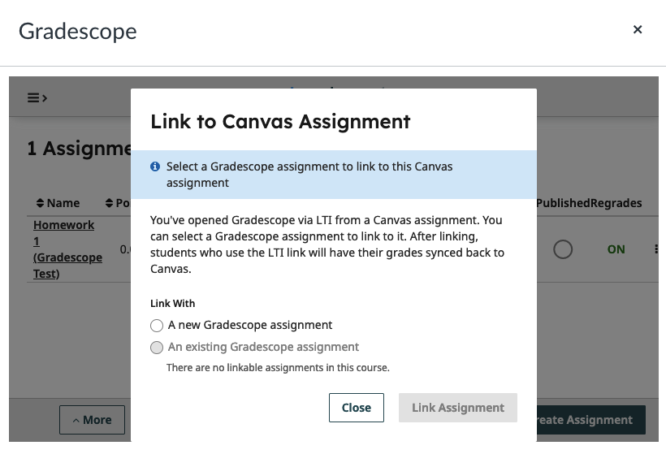
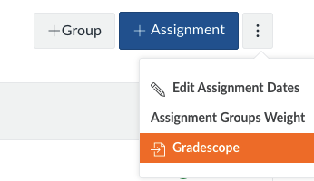
Creating Assignments - in Canvas
If you want to keep track of student scores in Canvas (Gradescope doesn’t really calculate course grades), it is important to link assignments.
On the Canvas Assignment page, click the three-dot menu and choose Gradescope. Choose a new assignment or link to an existing one.

Slide 9
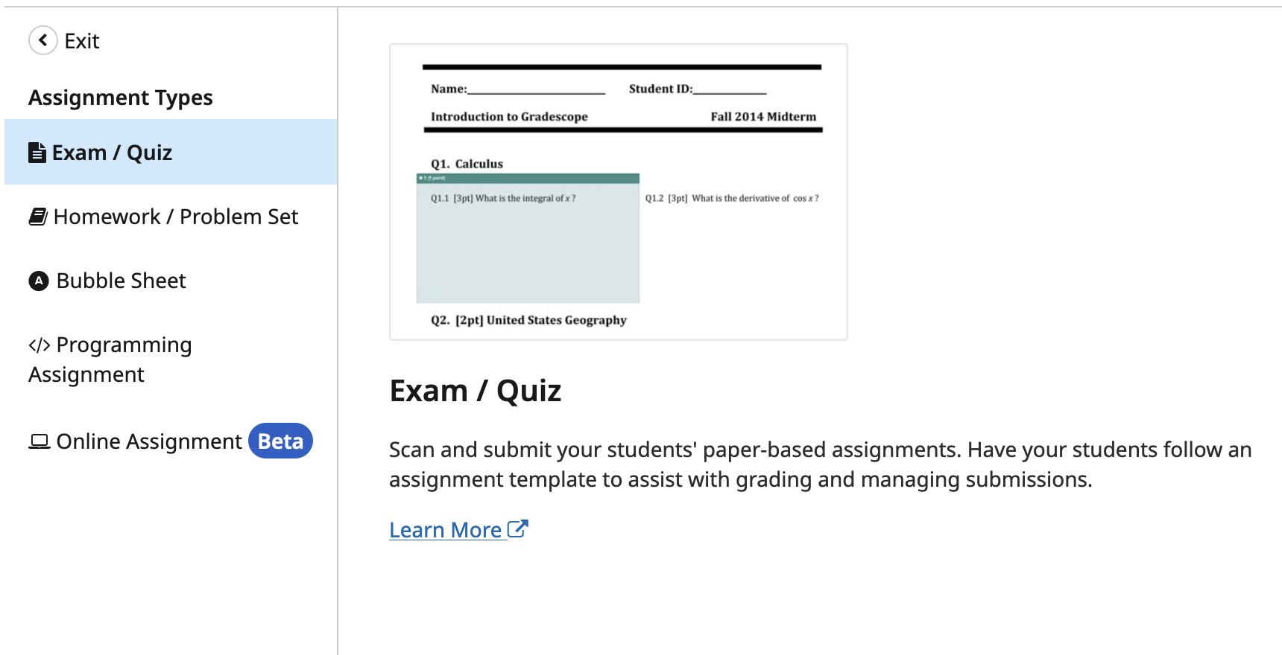
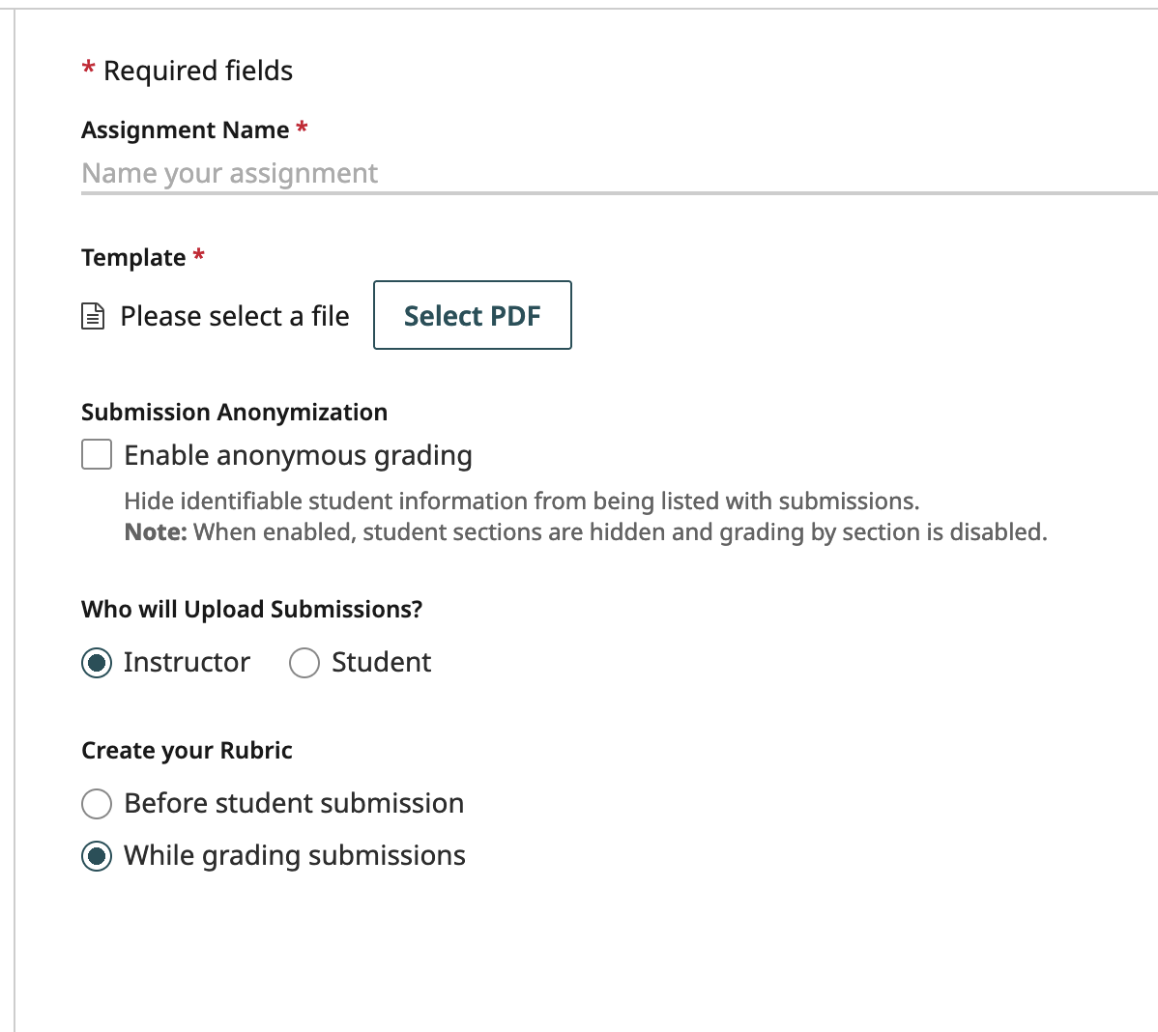
Creating Assignments - Exams
Exams require a “template” - the blank version of the exam or quiz that will be given to students to complete. You will use this template to assign points to each question in the next step.

Slide 10
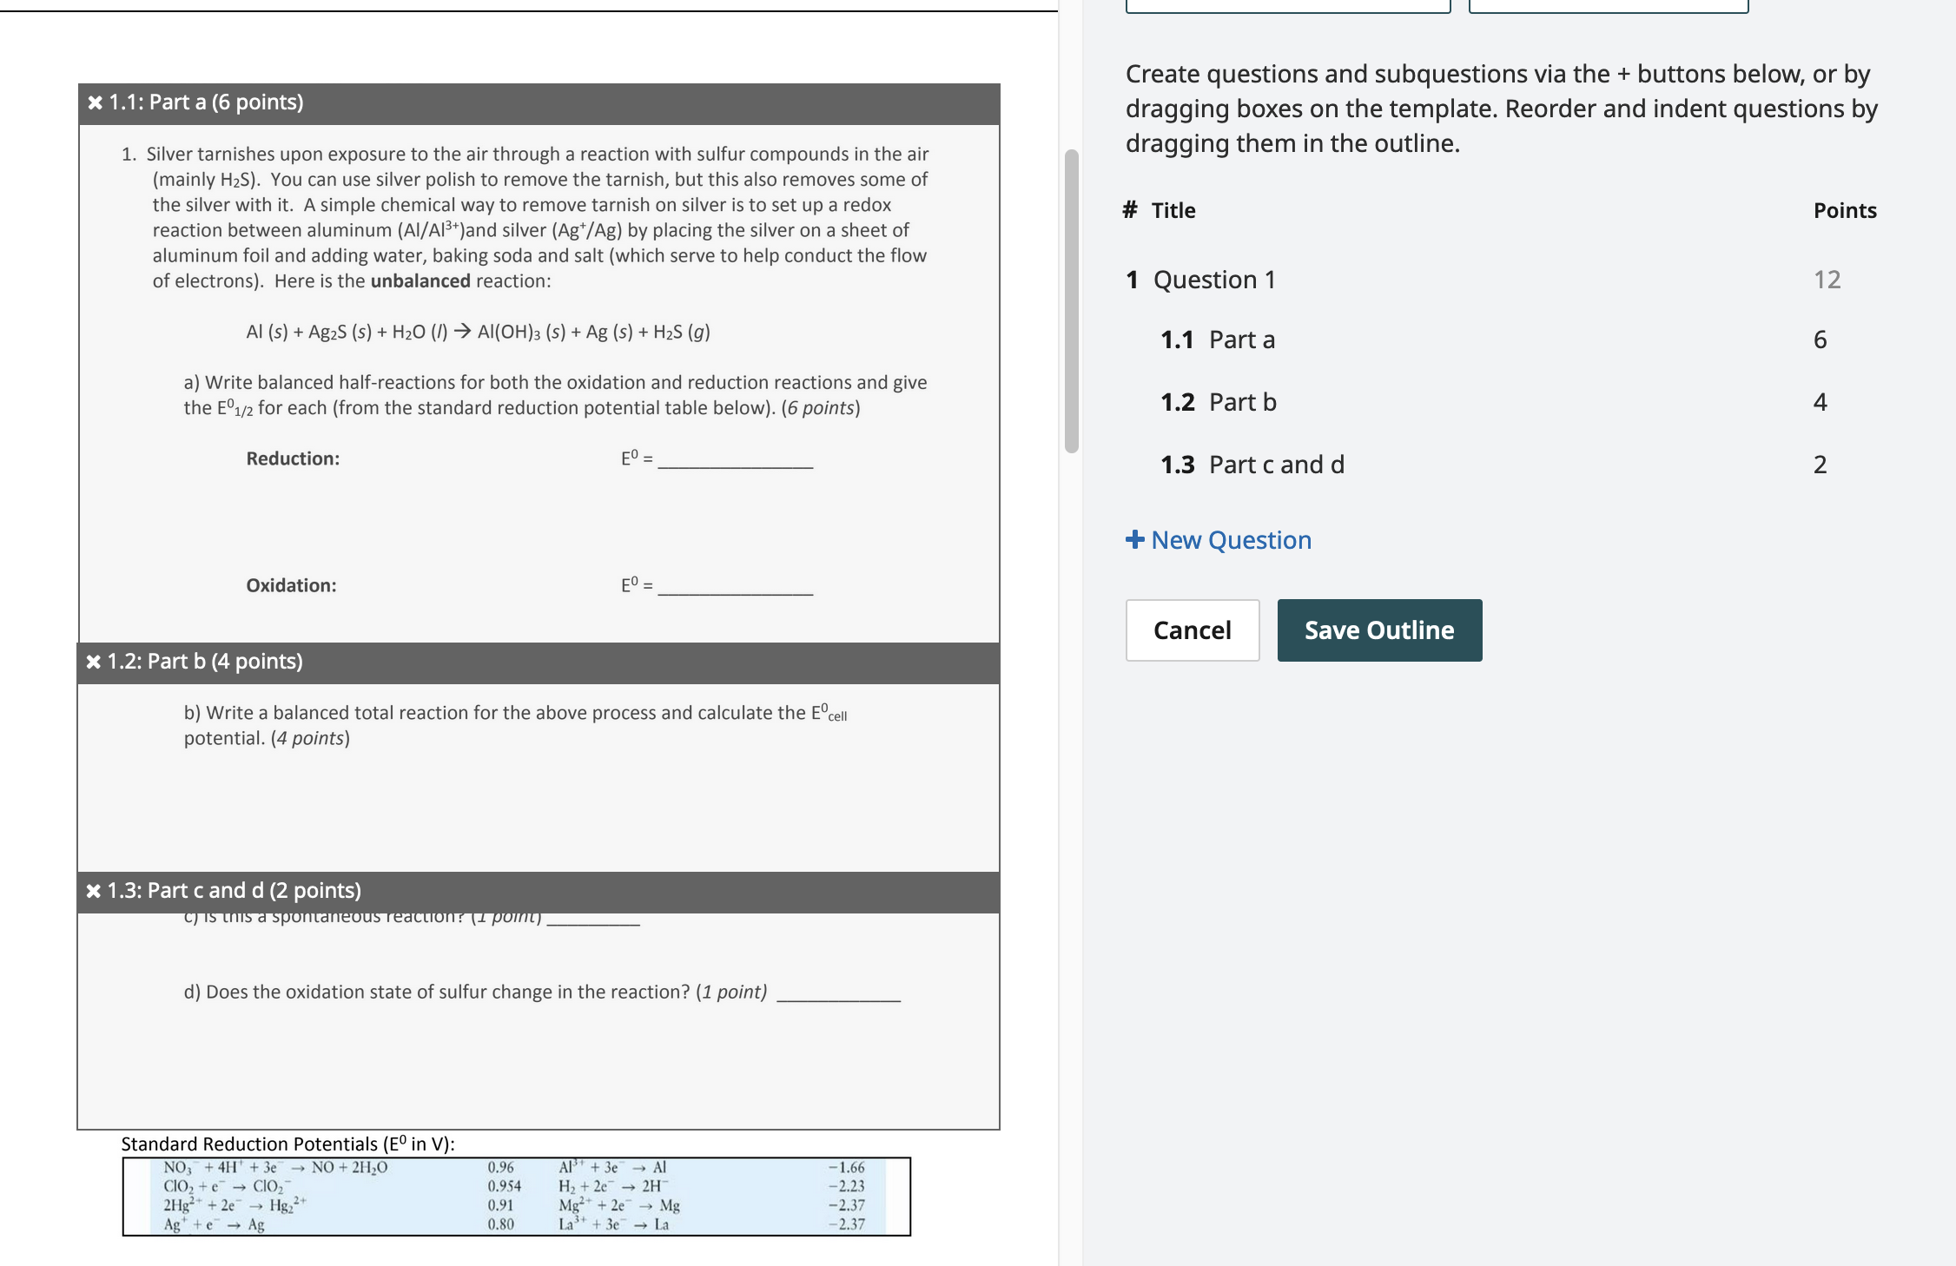
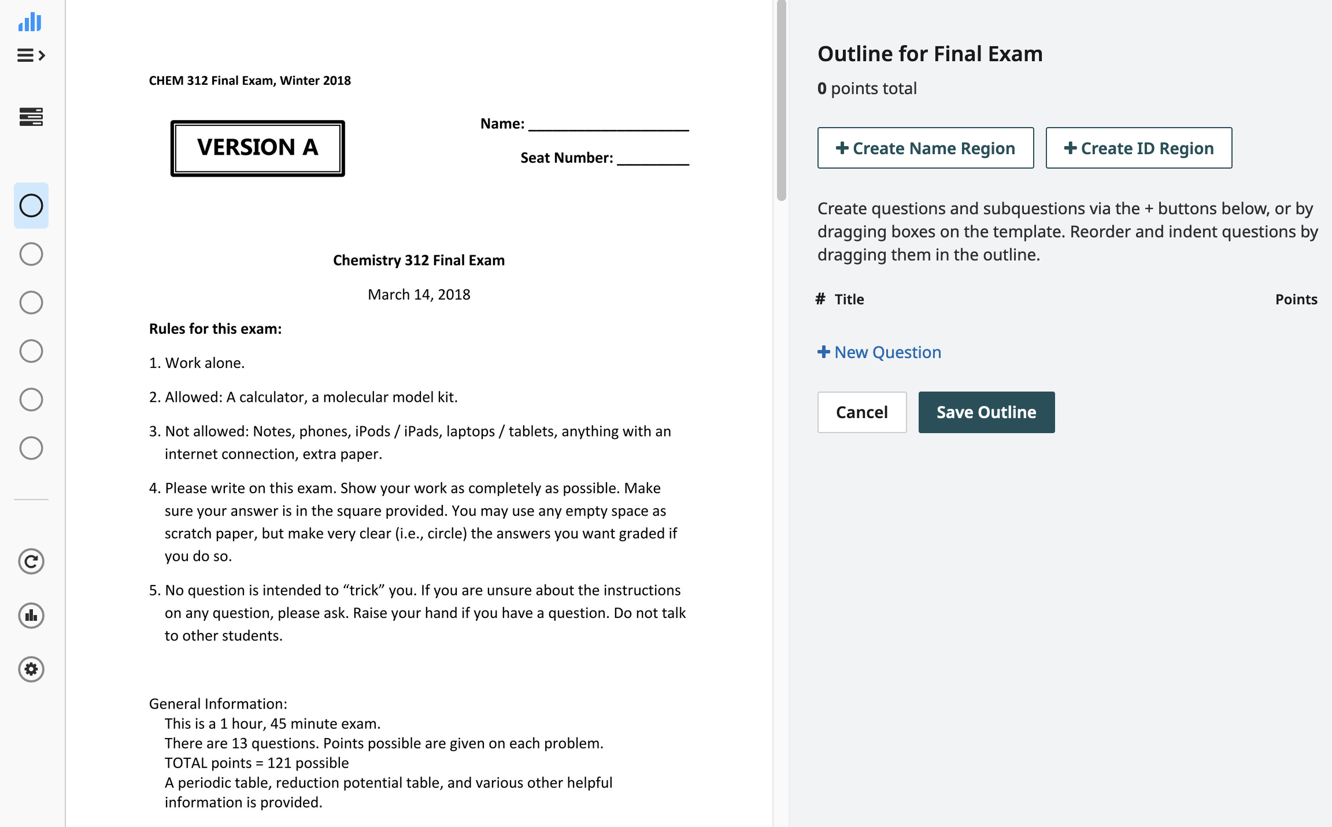
Creating Assignments - Exams
Once you have uploaded your exam file, Gradescope will ask you to create an outline:
Click “New Question” and draw a box around Question 1. Give the question a name (1 is ok) and assign points. You can also break the question into parts.
Save the outline when you are done - you can always update / edit your outline (even during / after grading).

Slide 11
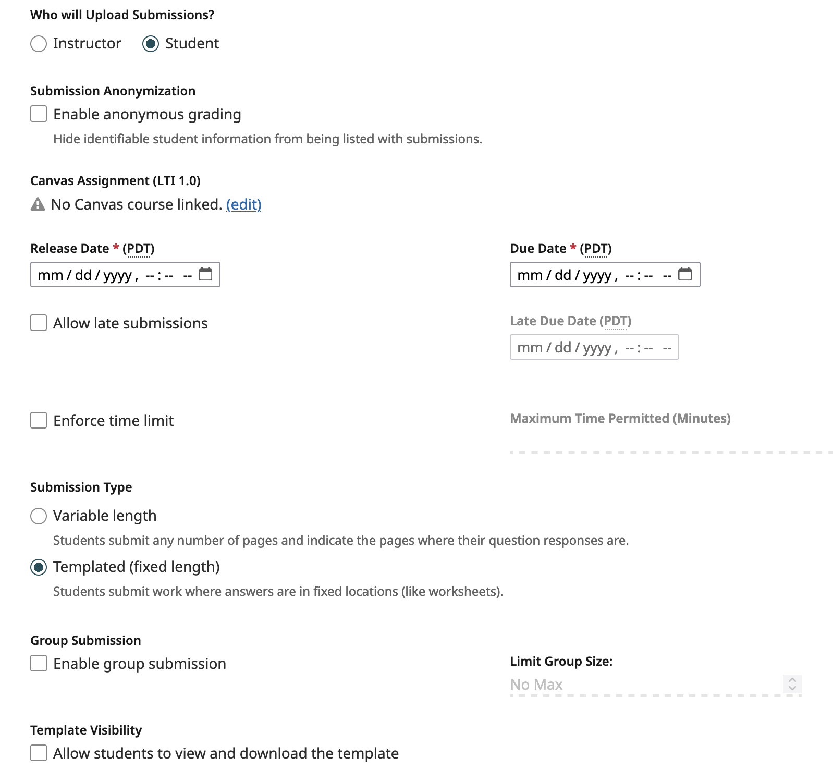
Creating Assignments - Exams
If students will be uploading the exam :
Specify the release, due, and late dates and times.
The time limit starts a timer as soon as they open the exam (students are asked to confirm they are ready to begin). Extensions can be managed separately in the “Extensions” menu.
Decide if the students will download the template from Gradescope or receive it another way.

Slide 12
Creating Assignments - Exams
Tips for exam grading in Gradescope:
Instructor submission (typical for in-person exams)
Draw boxes on your exam files to indicate where students should provide answers.
If collecting paper exams, cut off the corners and batch scan them to upload.
Student submission / no template
Have students draw boxes around their final answer for easier grading.
Teach students in advance how to ”assign pages” of their assignment - consider having them practice this.

Slide 13
Creating Assignments - Others
Homework / Problems Sets:
The process is identical to the one for exams
Bubble Sheet:
Gradescope has a 200-question bubble sheet template that can be autograded once you provide correct answers. Partial credit, either/or answers, and multiple versions are supported.
Programming Assignment:
Upload your autograder .zip file and have student code submissions graded automatically.
Online Assignment (Beta):
Build online quizzes in a relatively clunky interface. Many types of questions can be auto-graded. Recommend Canvas quizzes instead.

Slide 14
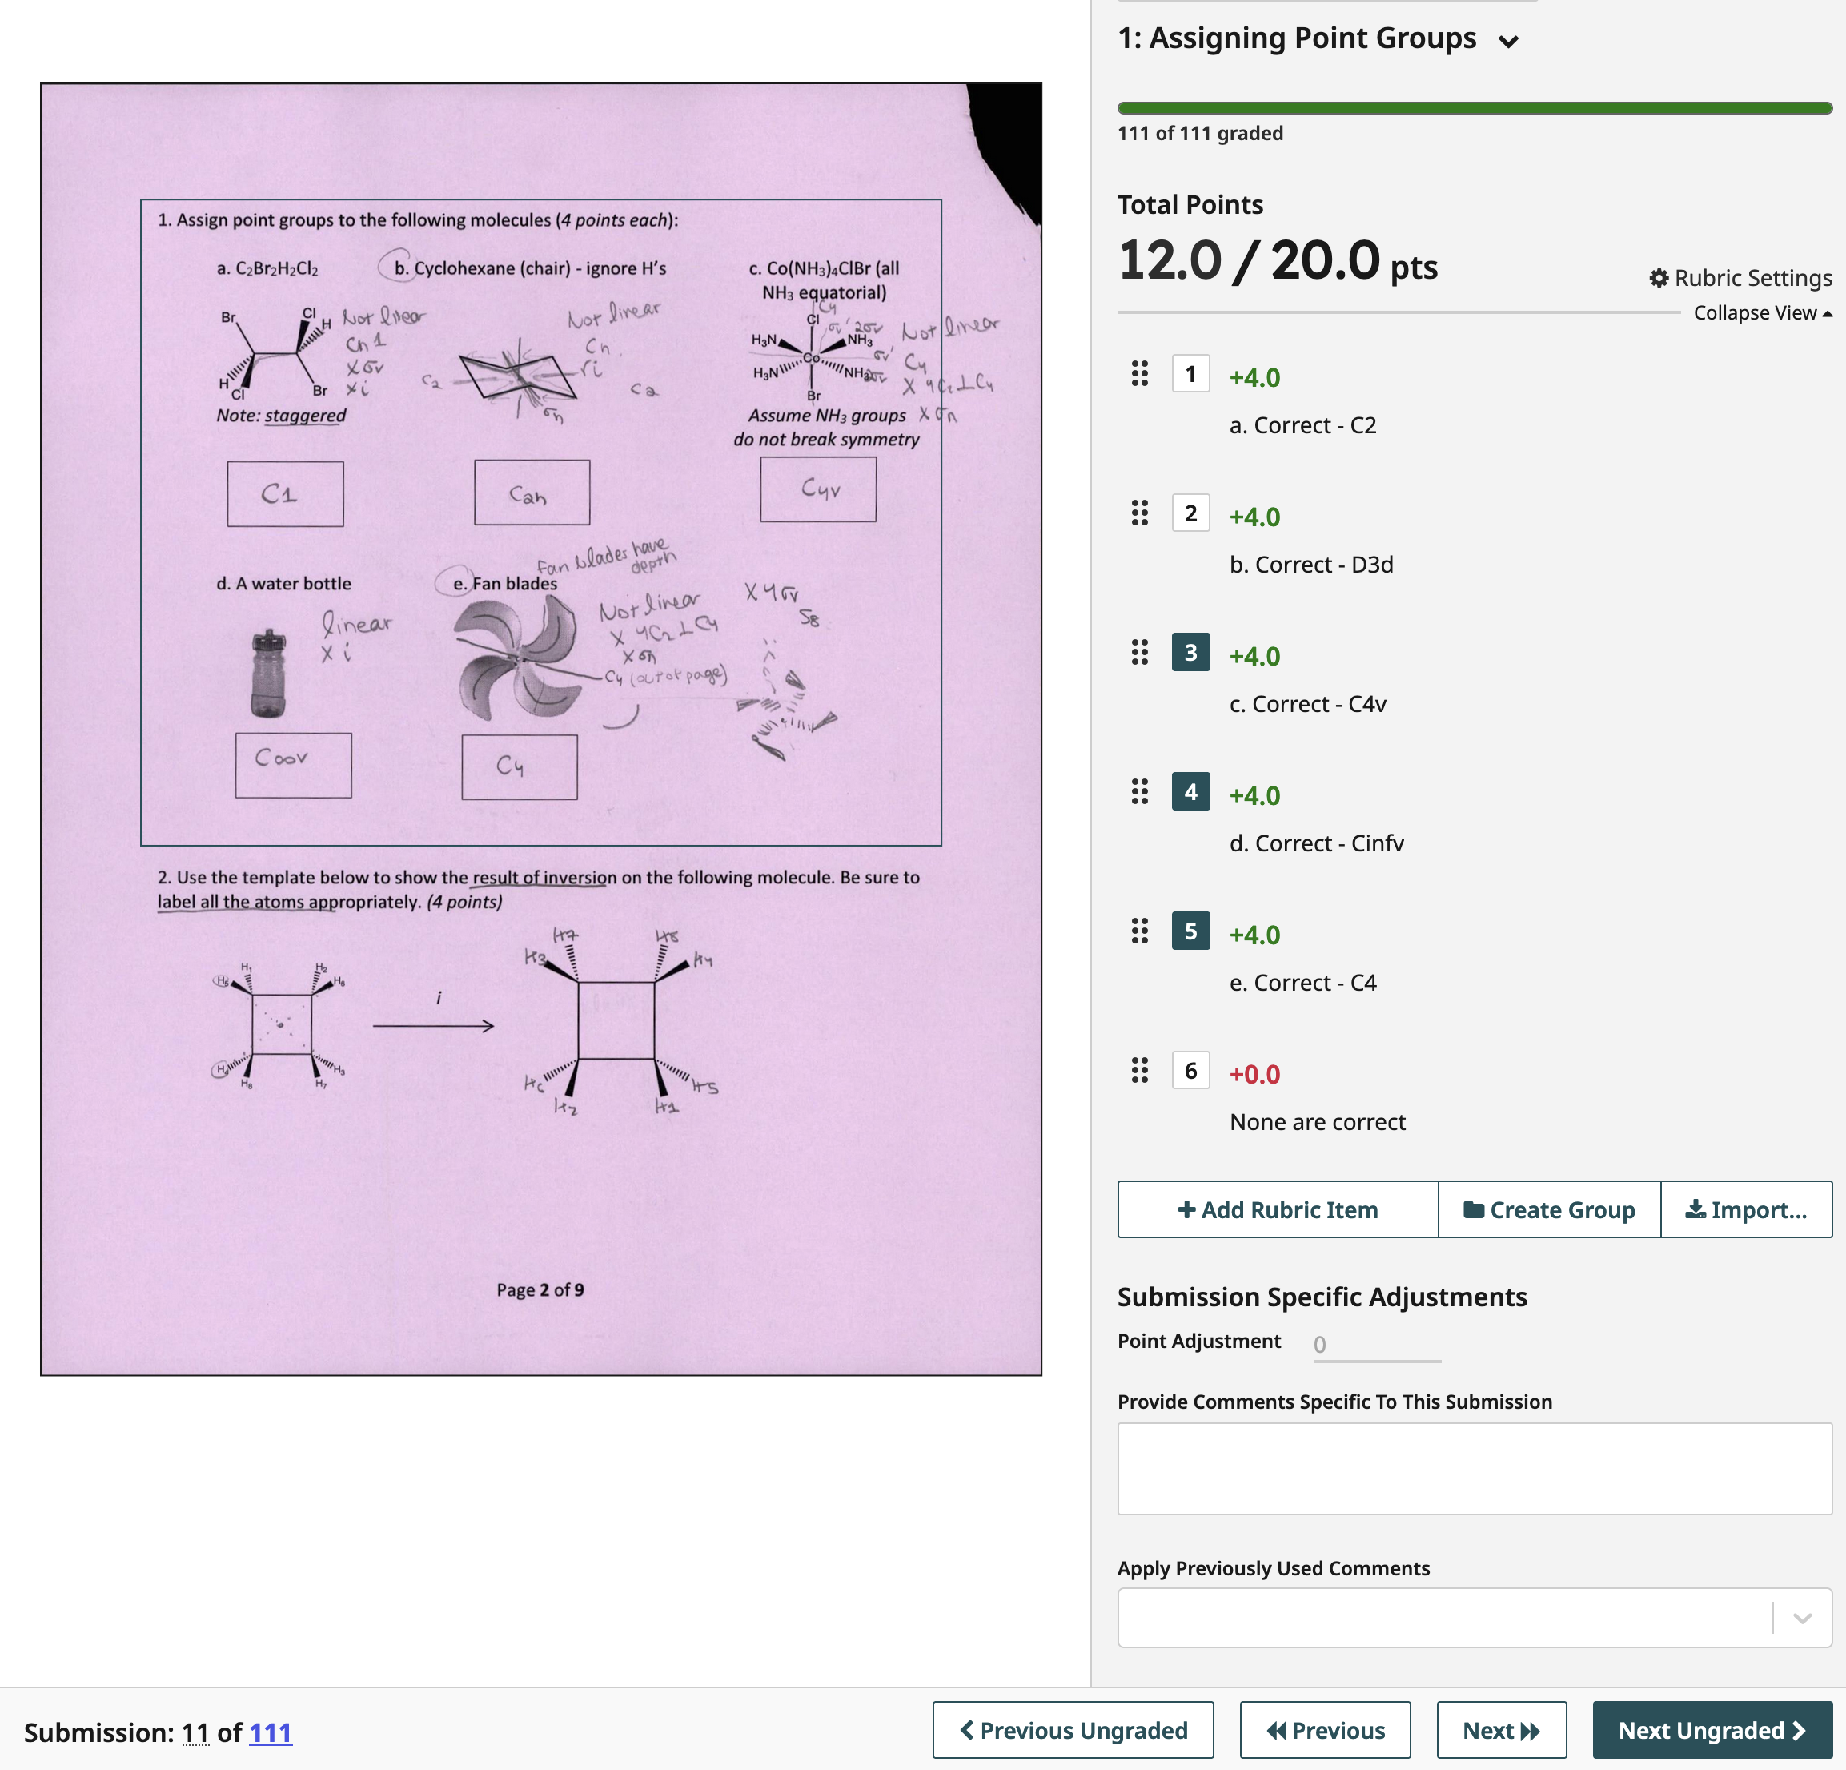
Grading
Grading is relatively straightforward and user-friendly, but a few tips:
Pressing the number of the rubric item toggles it off/on.
You must have a “not correct” item - every question needs a rubric selection or it remains ungraded.
Apply (and reuse) comments to a student.

Slide 15
Grading
More tips:
You can update the score for a rubric item and ALL scores will be updated automatically.
Something not covered in the rubric? Add a new item - you can also mix positive and negative scoring.
Clicking “Next Ungraded” takes you to the next student submission of the same problem - or simply press “z”

Slide 16
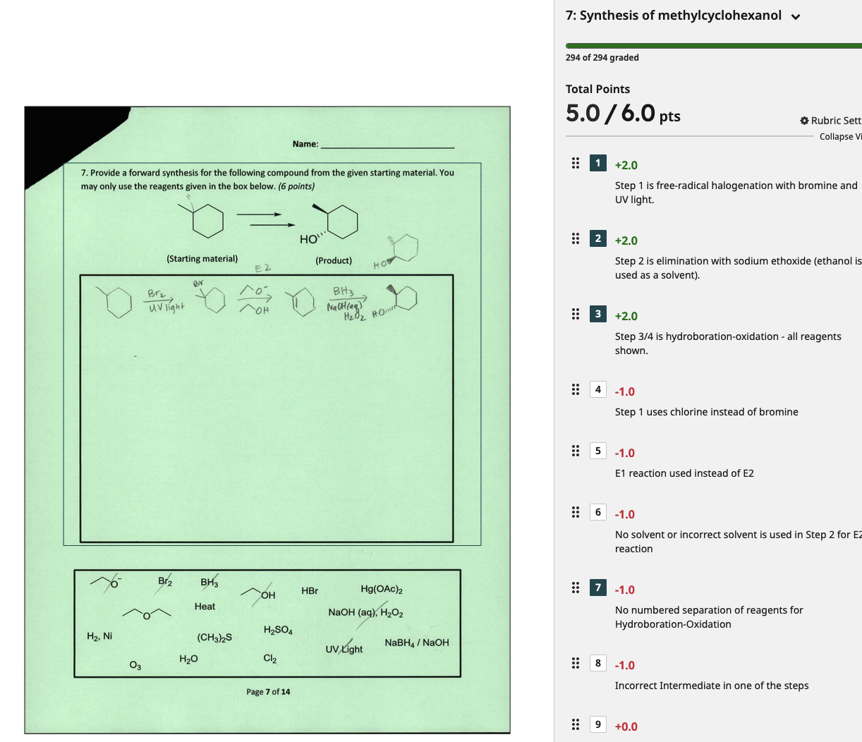
Grading
Simple or complex grading rubrics can be used.
Grading can be done by multiple users at once, with consistent tools

Slide 17
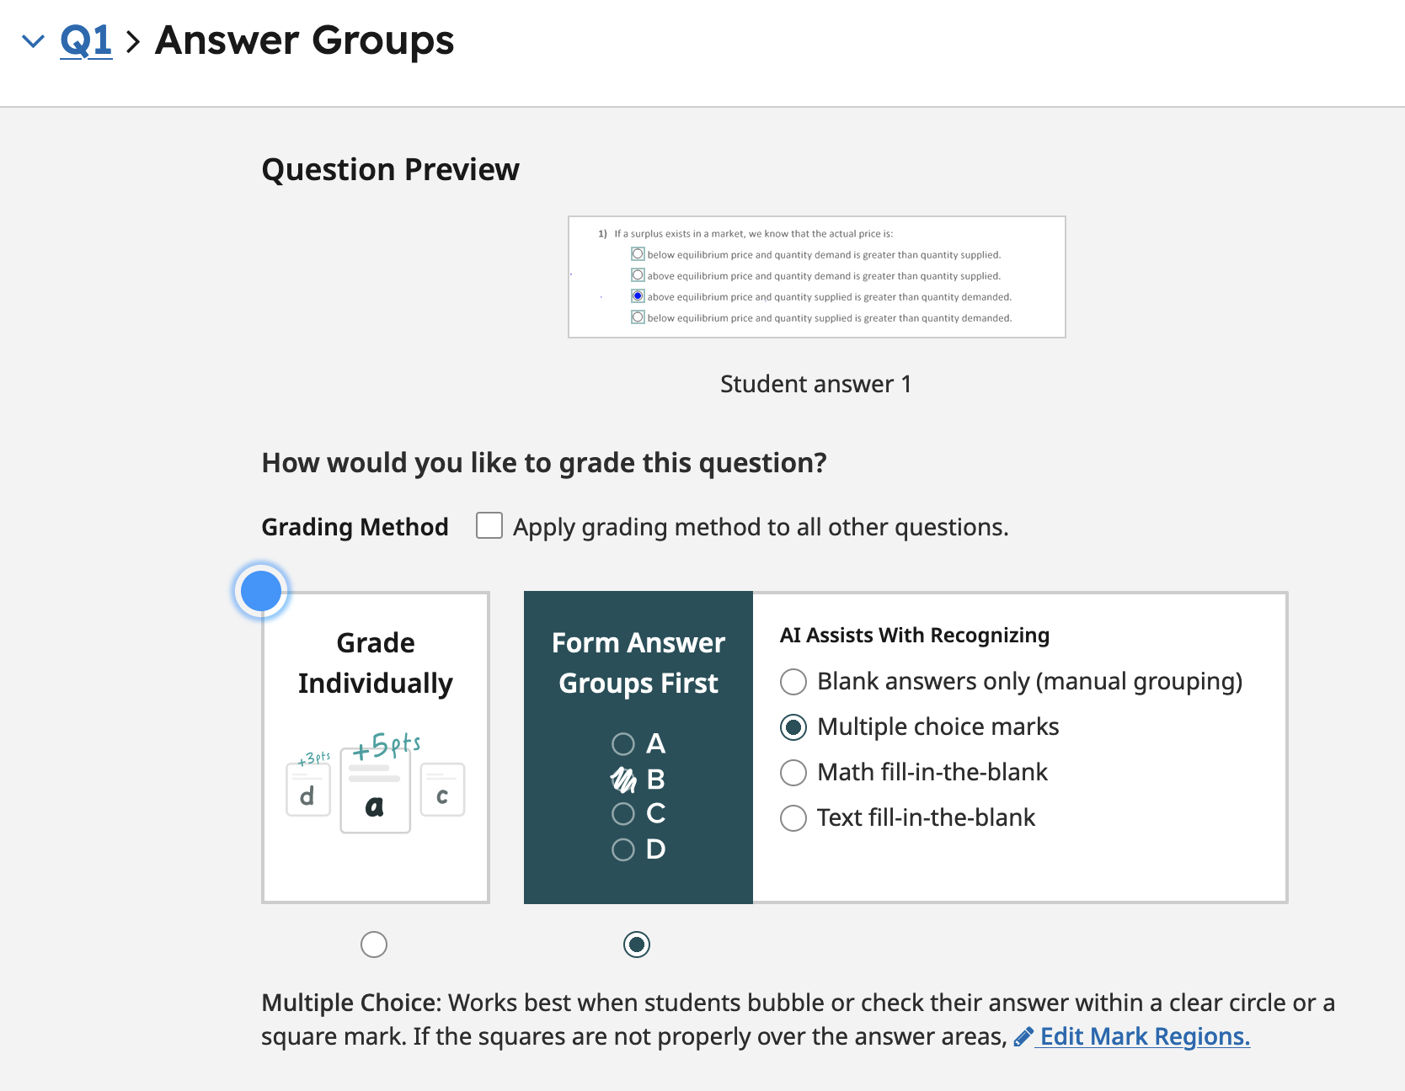
Group Grading
If you have a simple question - e.g., one in which a single answer is written in a box - you may want to consider group grading:
Question previews are shown.
Answers can be grouped
  correct
  incorrect
  half-right
  etc.
AI can assist with grouping

Slide 18
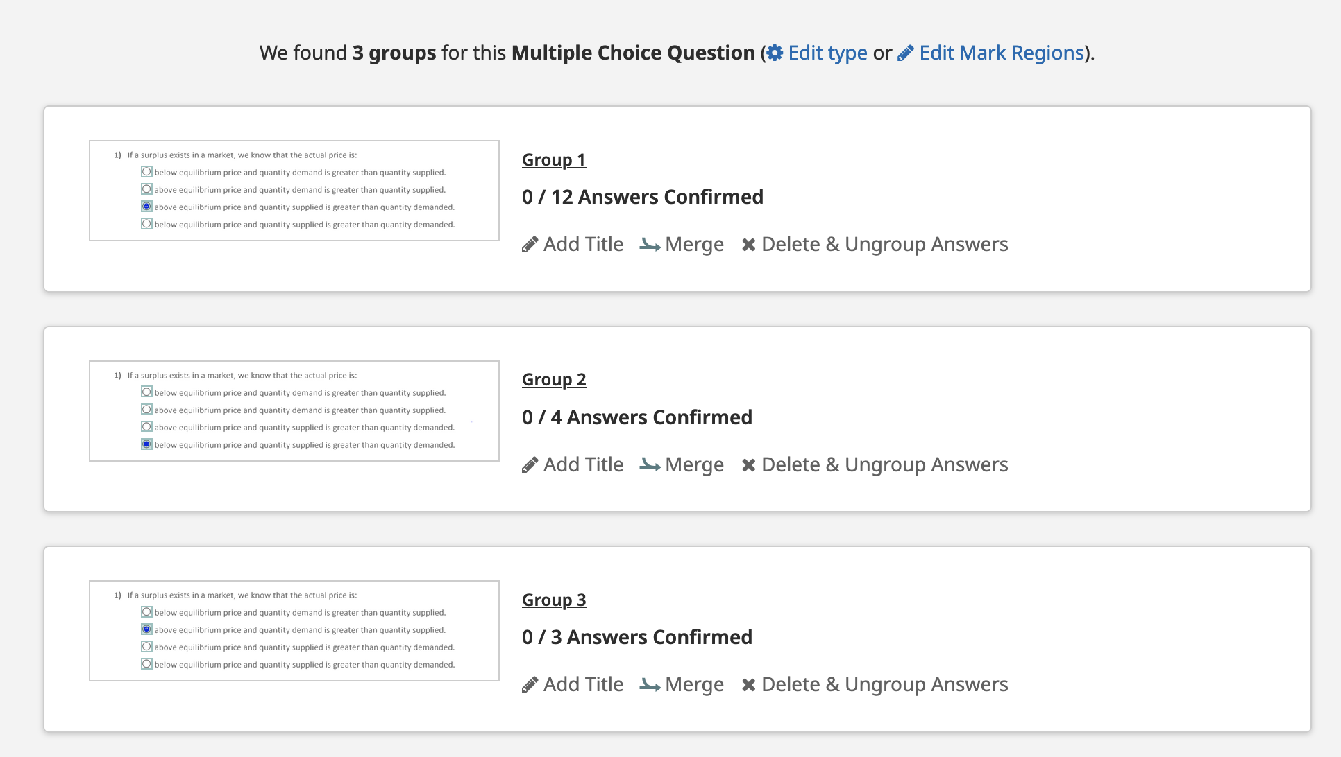
Group Grading
You title and confirm the groups, assign scores, and then all grouped answers are scored the same. You can always ungroup and grade manually.

Slide 19
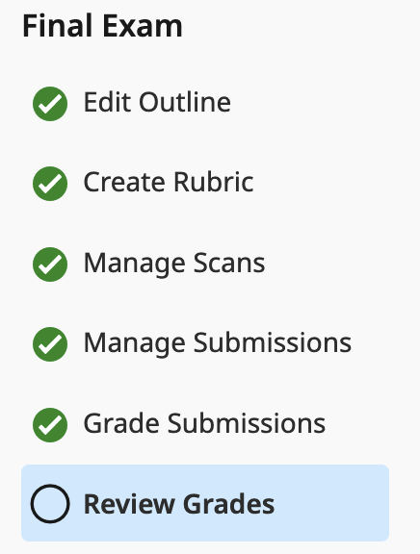
Syncing Grades
Once you have completed the grading (and possible regrading) of an assignment, you can publish and import grades to Canvas:
“Post grades to Canvas” fills in the Canvas gradebook with scores when the Gradescope assignment is linked to a canvas assignment.
“Publish Grades” allows students to see their scores and evaluations in the Gradescope environment - including the rubric items (if you allowed that), scoring, and comments.

Slide 20
Questions?

